Slide 1
Software Engineering
Software Engineering
The Product and the Process

Slide 2
Objectives:
What is computer software… really?
Why do we struggle to build high quality computer-based systems?
How can we categorize application domains for computer software?
What myths about software still exist?
What is a ‘software process’?
What are classic software engineering paradigms, its strengths and weaknesses

Slide 3
Software
➢ Computer instructions that when executed provide desired function and performance.
➢ Data structures that enable the programs to adequately manipulate information.
➢ Documents that describe the operation and use of programs.

Slide 4
Software-related Problems
1. Hardware advances continue to outpace our ability to build software to tap hardware’s potential.
2. Our ability to build new programs cannot keep pace with the demand for new programs, nor can we build programs rapidly enough to meet business and market needs.
3. The widespread use of computers has made society increasingly dependent on reliable operation of software.
4. We struggle to build computer software that has high reliability and quality.
5. Our ability to support and enhance existing programs is threatened by poor design and inadequate resources.
Notes:
Underutilization of Hardware - For example, a powerful multicore processor might not be fully utilized by software that cannot effectively parallelize tasks.
Inadequate Development Speed: It suggests that the rate at which software programs are being developed is not fast enough to meet the growing demand for new software applications. This could be due to various factors such as limited resources, complex development processes, or a shortage of skilled developers.

Slide 5
Software Characteristics
➢ Software is developed or engineered, it is not manufactured in the classical sense.
➢ Most software is custom-built, rather than being assembled from existing components.

Slide 6
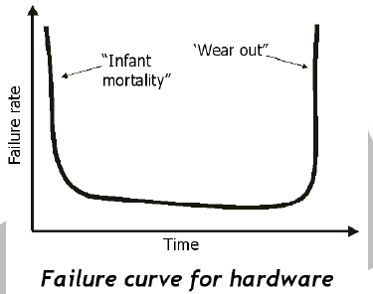
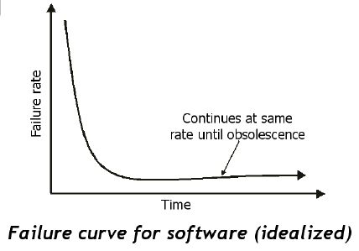
Software Characteristics
➢ Software doesn’t “wear out.”
Notes:
software does not degrade or deteriorate over time simply due to its continued use.
Software can be copied and executed without any loss of quality or functionality. When you run a software program, it operates in the same way as it did when it was first created, assuming there are no software defects or compatibility issues.

Slide 7
Sample Software Applications
➢ System Software
➢ Real-Time Software
➢ Business Software
➢ Engineering and Scientific Software
➢ Embedded Software
➢ Personal Computer Software
➢ Artificial Intelligence Software
Notes:
REAL-TIME SOFTWARE
Traffic Control Systems: Real-time software is used in traffic management and signal control systems to optimize traffic flow, reduce congestion, and improve road safety.
Aerospace and Spacecraft Control: Spacecraft rely on real-time software for navigation, propulsion, and communication with Earth. It ensures precise control during space missions.
Engineering and Scientific Software
MATLAB: MATLAB is a high-level programming environment widely used in engineering and scientific research for tasks such as data analysis, numerical simulations, and algorithm development. It offers specialized toolboxes for various applications.
AUTOCAD,

Slide 8
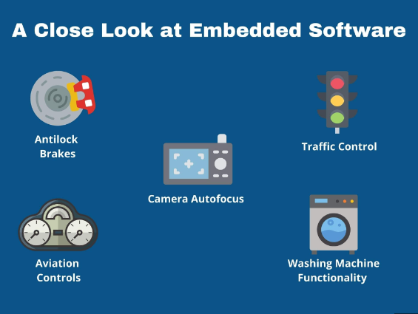
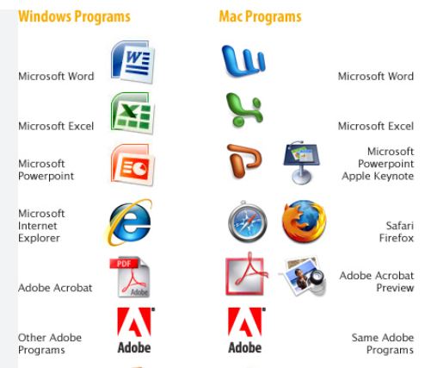
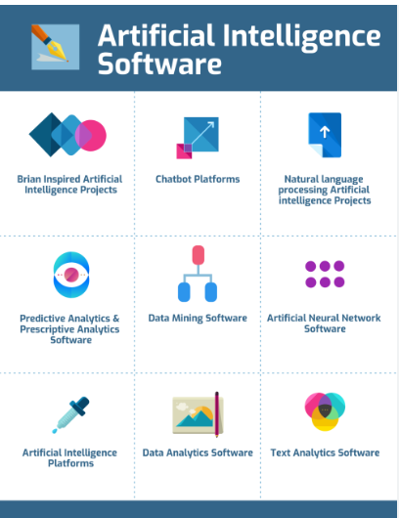

Slide 9
Software Engineering
According to Fritz Bauer, software engineering is the establishment and use of sound engineering principles in order to obtain economically software that is reliable and works efficiently on real machines.
According to IEEE, software engineering is the application of a systematic, disciplined, quantifiable approach to the development, operation, and maintenance of software – that is, the application of engineering to software.
Notes:
IEEE - Institute of Electrical and Electronics Engineers

Slide 10
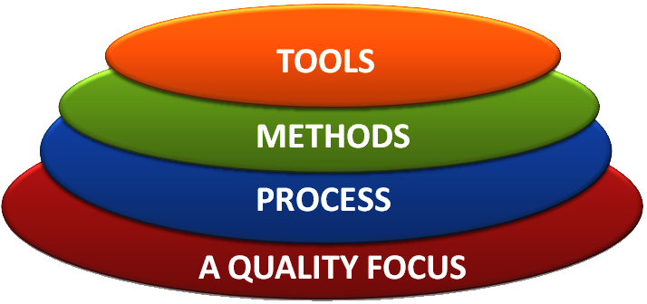
Software Engineering Layers
Software engineering is a layered technology. Any engineering approach must rest on an organizational commitment to quality.

Slide 11
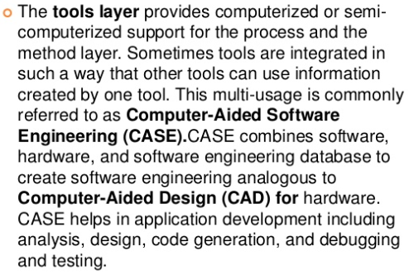
Tools — It offer support for the framework and the method each software engineering project will follow.

Slide 12
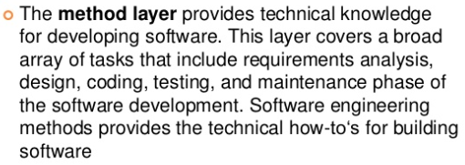
Methods — provide the technical “how to’s” for building software

Slide 13
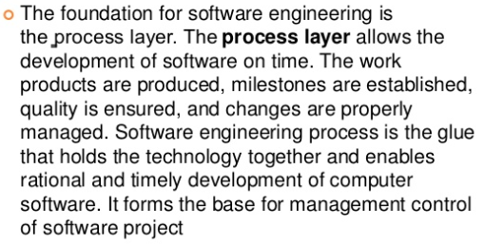
Process — the glue that holds the technology layers together and enables rational and timely development of computer software. This layer consists of the framework that must be established for the effective delivery of software.

Slide 14
Quality Focus - This layer is the fundamental layer for software engineering. As stated above it is of great importance to test the end product to see if it meets its specifications. Efficiency, usability, maintenance and reusability are some of the requirements that need to be met by new software.
Having Tools, Methods and Processes laid out from the beginning of any software engineering process makes it an easier task for both developers and project managers to check the quality of the end product and deliver a more complex software on time by staying on budget.

Slide 15








Tools
GitHub is a powerful collaboration tool and development platform for code review and code management. With this GitHub, the users can build applications and software, manage the projects, host the code, review the code etc.
NetBeans is an open source and a free software development tool written in Java that develops world-class web, mobile, and desktop applications easily and quickly. It uses C / C++, PHP, JavaScript, Java etc.
Initially in 2010 Cloud 9 was an open source, cloud-based IDE (Integrated Development Environment) that supports various programming languages like C, Perl, Python, JavaScript, PHP etc. Later in 2016, AWS (Amazon Web Service) acquired it for further improvement and made it chargeable as per the usage.
Bootstrap is an open source and free framework for developing responsive websites and mobile-first projects using CSS, HTML, and JS. Bootstrap is widely used to design faster and simpler websites.
Node.js is an open source, cross-platform and JavaScript run-time environment that is built to design a variety of web applications and to create web servers and networking tools.

Slide 16
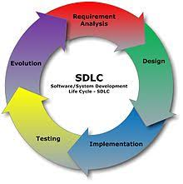
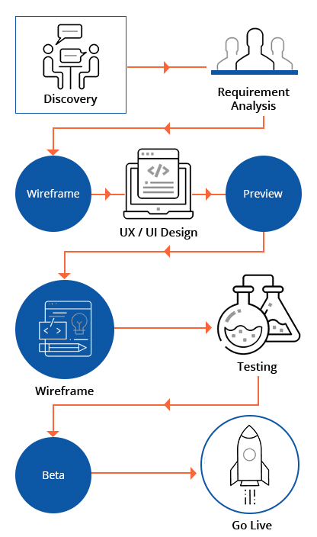
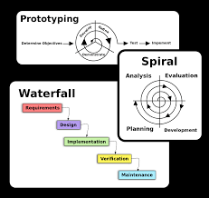
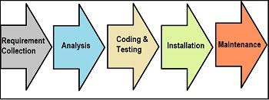
Method and Process

Slide 17
Software Engineering Paradigms
Software is more than just a program code. A program is an executable code, which serves some computational purpose. Software is considered to be a collection of executable programming code, associated libraries and documentations. Software, when made for a specific requirement is called a software product.
Classic Life Cycle
Prototyping
Spiral Model
Fourth Generation Technique
Object-Oriented Model

Slide 18
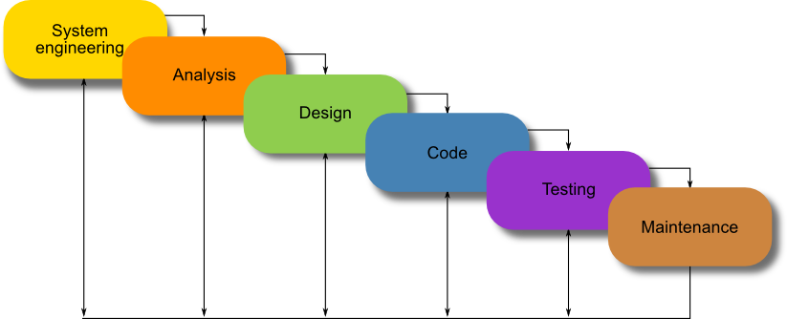
Waterfall Lifecycle
The Waterfall Model was the first Process Model to be introduced. It is very simple to understand and use. In a Waterfall model, each phase must be completed before the next phase can begin and there is no overlapping in the phases. The waterfall model is the earliest SDLC approach that was used for software development.
In “The Waterfall” approach, the whole process of software development is divided into separate phases. The outcome of one phase acts as the input for the next phase sequentially. This means that any phase in the development process begins only if the previous phase is complete.

Slide 19
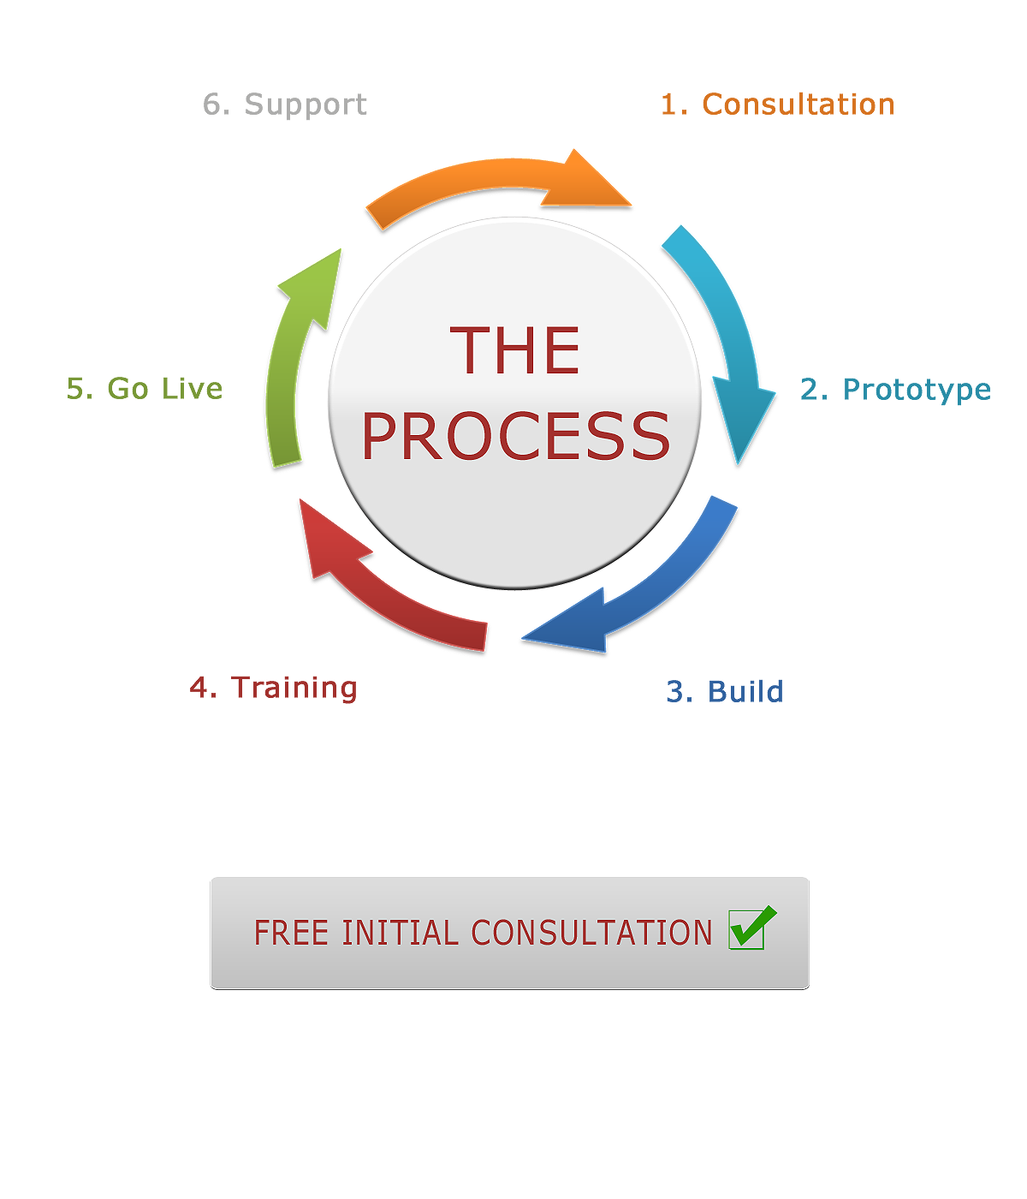
Prototyping Model
Prototype Model is an early sample, model, or release of a product built to test a concept or process. It is a term used in a variety of contexts, including semantics, design, electronics, and software programming. A prototype is designed to test and try a new design to enhance precision by system analysts and users. Prototyping serves to provide specifications for a real, working system rather than a theoretical one.
The basic idea here is that instead of freezing the requirements before a design or coding can proceed, a throwaway prototype is built to understand the requirements. This prototype is developed based on the currently known requirements. By using this prototype, the client can get a model or sample of the product.

Slide 20
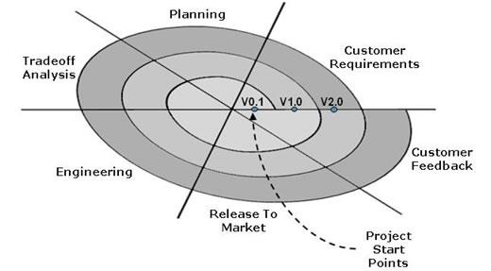
Spiral Model
Spiral Model is a combination of Iterative Development Model and Waterfall Model with very high emphasis on risk analysis. It allows for incremental releases of the product, or incremental refinement through each iteration around the spiral.
This model is best used for large projects which involves continuous enhancements. There are specific activities which are done in one iteration (spiral) where the output is a small prototype of the large software. The same activities are then repeated for all the spirals till the entire software is build.

Slide 21
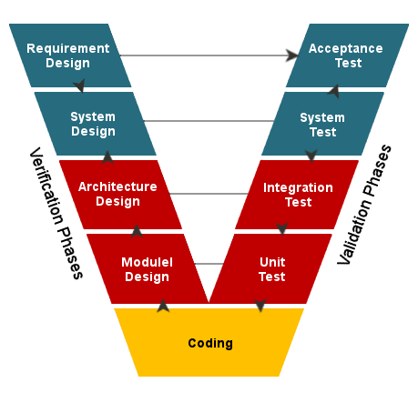
V Model
The V-Model is SDLC model where execution of processes happens in a sequential manner in V-shape. It is also known as Verification and Validation Model. V-Model is an extension of the Waterfall Model and is based on association of a testing phase for each corresponding development stage. This means that for every single phase in the development cycle there is a directly associated testing phase. This is a highly disciplined model and next phase starts only after completion of the previous phase.

Slide 22
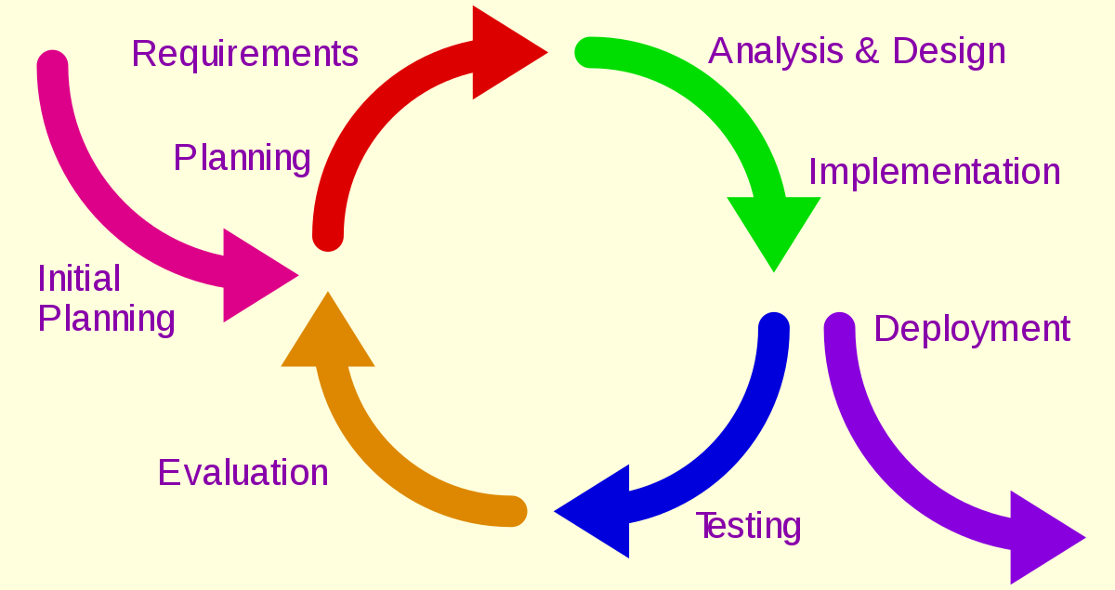
Iterative Model
The Incremental Model is a method of software development where the product is designed, implemented and tested incrementally. Little more is added each time until the product is finished. It involves both development and maintenance.

Slide 23
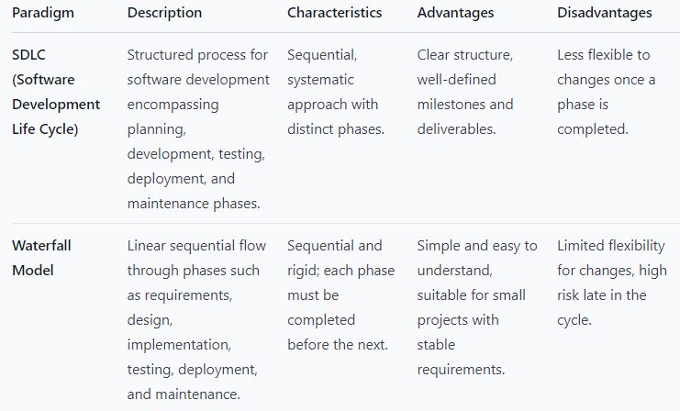

Slide 24
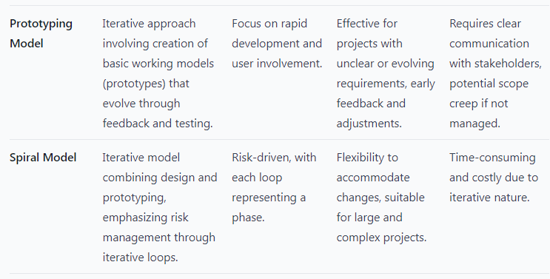

Slide 25
